Slide 1

Customer Retention Analysis – Canada Vapes
Group 5:
Neel Manishbhai Mendapara - 1275495
Nischith Sudarshan Reddy - 1258755
Parth Mihirbhai Patel - 1292923
Philip Maliki Amedu - 1238583
Pooja Somashekar - 1258760

Slide 2

Business Context & Challenge
Company Overview
E-commerce retailer specializing in vaping products
Operates across Canada with growing customer base
Strong monthly customer acquisition (500–700 new customers)
Business Challenge
High acquisition but low customer retention
Many customers do not return after first purchase
Current: ~3,500 returning customers
Target: Increase to 5,000 returning customers

Slide 3
Project Objective
Analyze customer behavior after first purchase
Identify early indicators of retention and churn
Examine key factors: order value, items purchased, product selection
Develop data-driven strategies to improve retention
Support business goal of increasing returning customers

Slide 4
Data & Analytical Approach
Customer dataset: total orders, spending, average order value, location
Transaction dataset: purchase date, products, items sold, net sales
Data preparation: cleaning, handling missing values, merging datasets
Created Customer_ID for consistent tracking
Applied exploratory and behavioral analysis techniques

Slide 5
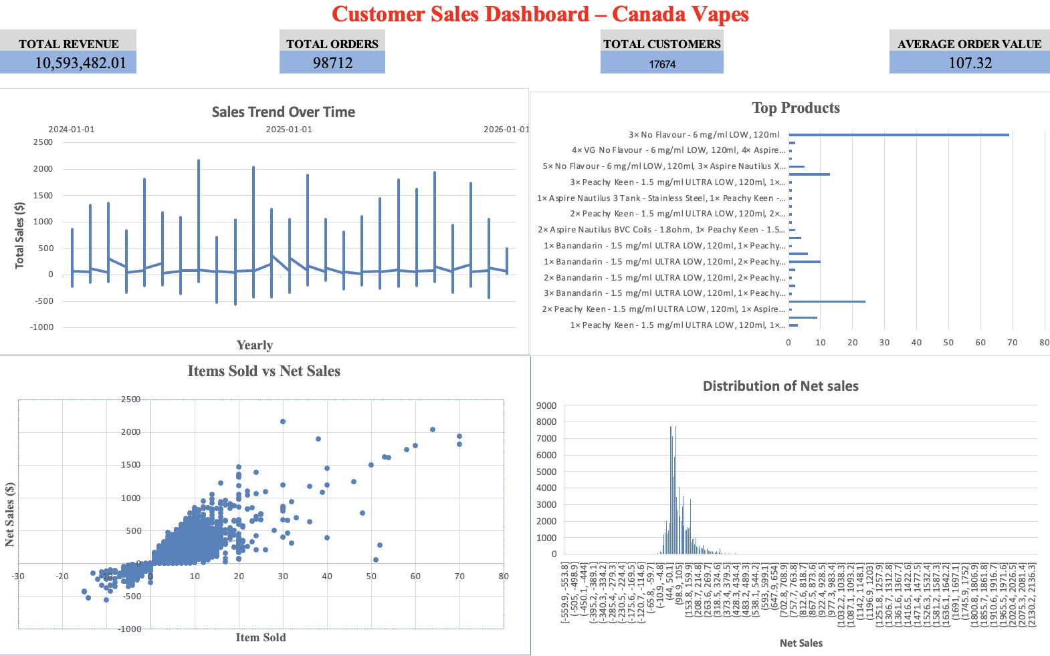
Key Performance Overview
Total Revenue: Overall business performance
Total Orders: Customer activity level
Total Customers: Customer base size
Average Order Value (AOV): Spending behavior

Slide 6
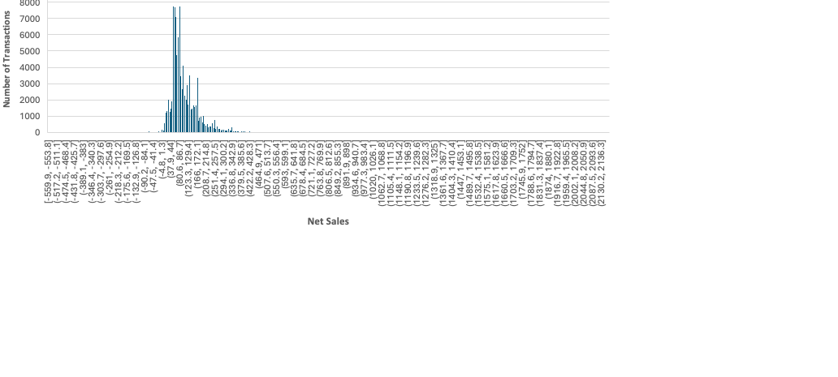
Sales Distribution
Majority of transactions are low to moderate value
Few high-value transactions contribute significantly
Indicates uneven revenue distribution

Slide 7
Yearly Sales Trend
Sales fluctuate across months
Indicates changing customer demand
Possible impact of promotions or seasonality
Opportunity to optimize marketing timing

Slide 8
Items Sold vs Net Sales
Strong positive relationship observed
More items → higher transaction value
Indicates higher engagement level
Key driver of revenue and retention

Slide 9
Top Products Purchased
Demand concentrated among few products
Not evenly distributed across catalog
High-performing products drive engagement
Opportunity for targeted promotions

Slide 10
Key Insights
Higher AOV → stronger engagement
Multi-item purchases → higher revenue
Revenue concentrated among fewer customers
Demand focused on key products
Early engagement is critical

Slide 11

Recommendations
Introduce product bundling strategies
Implement early post-purchase engagement (7–14 days)
Promote high-performing products
Offer incentives to increase order value
Target high-value customers

Slide 12
Expected Business Impact
Increase repeat purchase rate
Improve customer engagement
Higher average order value
Stronger customer retention
Achieve 5,000 returning customers

Slide 13
Conclusion
Retention is Predictable, Not Random
First Purchase is Critical
Customer Behavior Drives Outcomes
Data-driven Strategies Improve Performance

